Slide 1
DP-600: Microsoft Fabric Analytics Engineer
Day 2
Notes:
Instructor notes and guidance.
This space has been left deliberately blank

Slide 2
Get started with data warehouses in Microsoft Fabric
Notes:
https://aka.ms/fabric-warehouse
Before delivering this presentation, review the associated module on Microsoft Learn.
The estimated time to present these slides is 45 minutes.

Slide 3




Data warehouse fundamentals
Data ingestion
Data storage
Data processing
Data analysis and delivery
Move data from source systems into a data warehouse.
Store the data in a format that is optimized for analytics.
Transform the data into a format that is ready for consumption by analytical tools.
Analyze the data to gain insights and delivering those insights to the business.
Notes:
Microsoft Fabric enables data engineers and analysts to ingest, store, transform, and visualize data all in one tool with both a low-code and traditional experience.
Fabric's data warehouse is a relational data warehouse that supports the full transactional T-SQL capabilities you'd expect from an enterprise data warehouse. It's a fully managed, scalable, and highly available data warehouse that can be used to store and query data in the Lakehouse. Using the data warehouse, you're fully in control of creating tables, loading, transforming, and querying data using either the Fabric portal or T-SQL commands. You can use SQL to query and analyze the data, or use Spark to process the data and create machine learning models.
Data warehouses in Fabric facilitate collaboration between data engineers and data analysts, working together in the same experience. Data engineers build a relational layer on top of data in the Lakehouse, where analysts can use T-SQL and Power BI to explore the data.

Slide 4
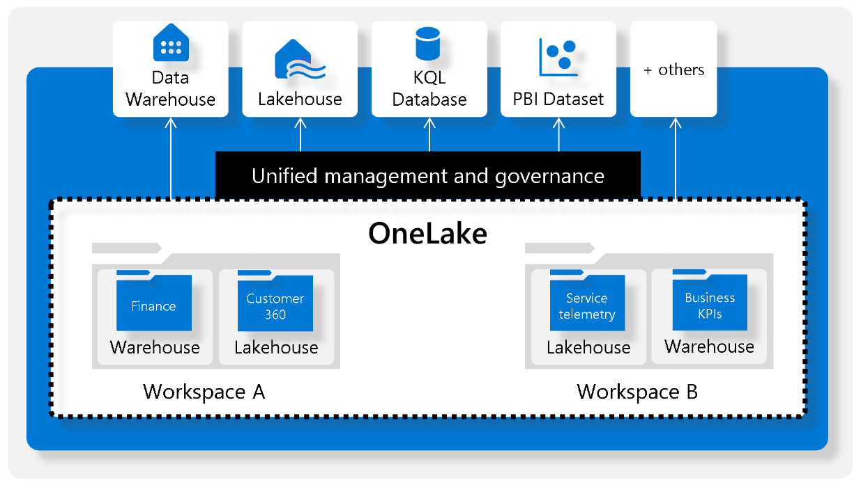
Understand Fabric warehouses
Centered on single data lake
Powered by Synapse Analytics
Fully supports T-SQL
Parquet file format
Notes:
Explain the OneLake architecture that hosts lakehouses and warehouses all in a unified storage location, and then allows different items to access that data as needed without duplication.

Slide 5
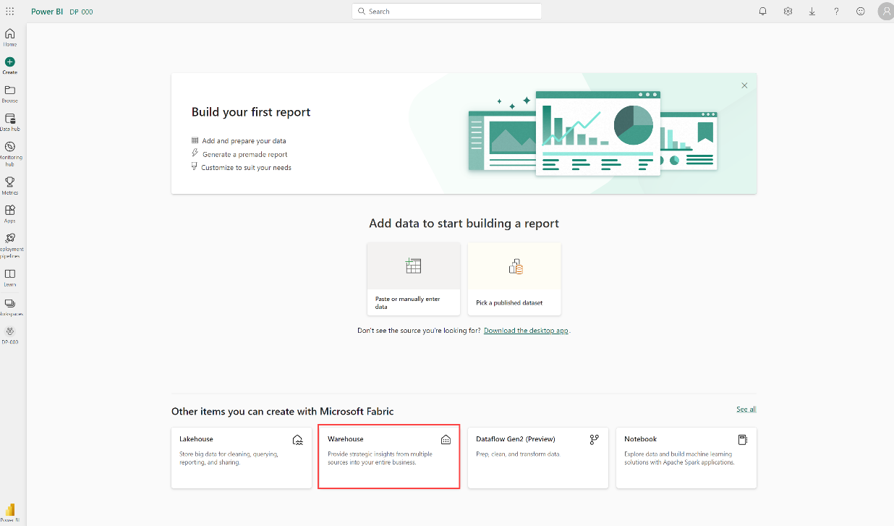
Create a data warehouse in Fabric
Within Fabric service portal
Navigate to Fabric workspace
Select new item > Warehouse
Name warehouse
Notes:
There are multiple ways to create new items within Fabric. The text demonstrates one way, and the screenshot shows another.

Slide 6
Design a data warehouse
Like all relational databases, Fabric's data warehouse contains tables to store your data for analytics.
Fact tables:
Contain the numerical data that you want to analyze.
Dimension tables:
Contain descriptive information about the data in the fact tables.
Typically have a large number of rows and are the primary source of data for analysis.
Typically have a small number of rows and are used to provide context for the data in the fact tables.
It's common for a dimension table to include two key columns: surrogate key and an alternate key.
© Copyright Microsoft Corporation. All rights reserved.
Notes:
Microsoft Fabric enables data engineers and analysts to ingest, store, transform, and visualize data all in one tool with both a low-code and traditional experience.
Fabric's data warehouse is a relational data warehouse that supports the full transactional T-SQL capabilities you'd expect from an enterprise data warehouse. It's a fully managed, scalable, and highly available data warehouse that can be used to store and query data in the Lakehouse. Using the data warehouse, you're fully in control of creating tables, loading, transforming, and querying data using either the Fabric portal or T-SQL commands. You can use SQL to query and analyze the data, or use Spark to process the data and create machine learning models.
Data warehouses in Fabric facilitate collaboration between data engineers and data analysts, working together in the same experience. Data engineers build a relational layer on top of data in the Lakehouse, where analysts can use T-SQL and Power BI to explore the data.

Slide 7
Special types of dimension tables
Time dimensions provides information about the time period in which an event occurred.
Slowly changing dimensions are dimension tables that track changes to dimension attributes over time, like changes to a customer's address or a product's price.
Notes:
Time dimensions - This table enables data analysts to aggregate data over temporal intervals. For example, a time dimension might include columns for the year, quarter, month, and day in which a sales order was placed.
Slowly changing dimensions - They're significant in a data warehouse because they enable users to analyze and understand changes to data over time. Slowly changing dimensions ensure that data stays up-to-date and accurate, which is imperative to making good business decisions.

Slide 8
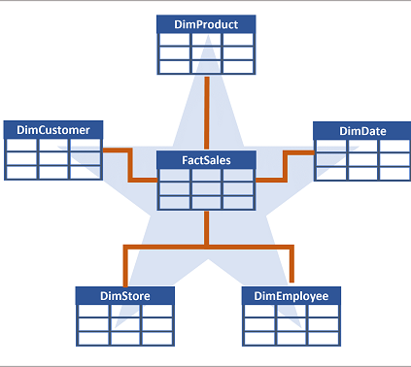
Data warehouse schema design (1/2)
A data warehouse is organized as a star schema, in which a fact table is directly related to the dimension tables.
Notes:
In most transactional databases that are used in business applications, the data is normalized to reduce duplication. In a data warehouse however, the dimension data is generally de-normalized to reduce the number of joins required to query the data.
You can use the attributes of something to group together numbers in the fact table at different levels. For example, you could find the total sales revenue for a whole region or just for one customer. The information for each level can be stored in the same dimension table.

Slide 9
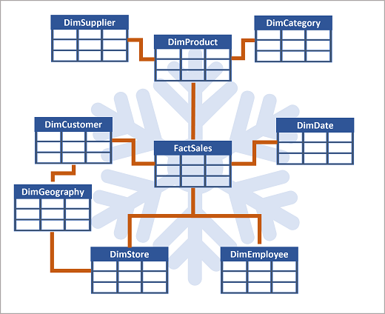
Data warehouse schema design (2/2)
If there are lots of levels or some information is shared by different things, it might make sense to use a snowflake schema instead.
Notes:
In this case, the DimProduct table has been split up (normalized) to create separate dimension tables for product categories and suppliers.
Each row in the DimProduct table contains key values for the corresponding rows in the DimCategory and DimSupplier tables.
A DimGeography table has been added containing information on where customers and stores are located.
Each row in the DimCustomer and DimStore tables contains a key value for the corresponding row in the DimGeography table.

Slide 10
Ingest data into a data warehouse
Fabric Pipelines
Fabric Dataflows Gen2
Cross-database querying
COPY INTO command
Notes:
Connect to the Fabric service portal to create pipelines or dataflows.
Once data is loaded into the warehouse, many of the following points will be familiar for Power BI users.

Slide 11
Clone tables
Replicas of tables created by copying the metadata while still referencing the same data files in OneLake.
Development and testing
Data recovery
Historical reporting
Notes:
You can create zero-copy table clones with minimal storage costs in a data warehouse. These clones are essentially replicas of tables created by copying the metadata while still referencing the same data files in OneLake. This means that the underlying data stored as parquet files is not duplicated, which helps in saving storage costs.
[Table clones](/fabric/data-warehouse/clone-table) are particularly useful in several scenarios.
Development and testing: Clones allow developers and testers to create copies of tables in lower environments, facilitating development, debugging, testing, and validation processes.
Data recovery: In the event of a failed release or data corruption, table clones can retain the previous state of data, enabling data recovery.
Historical reporting: They help create historical reports that reflect the state of data at specific points in time and preserve data at specific business milestones.

Slide 12
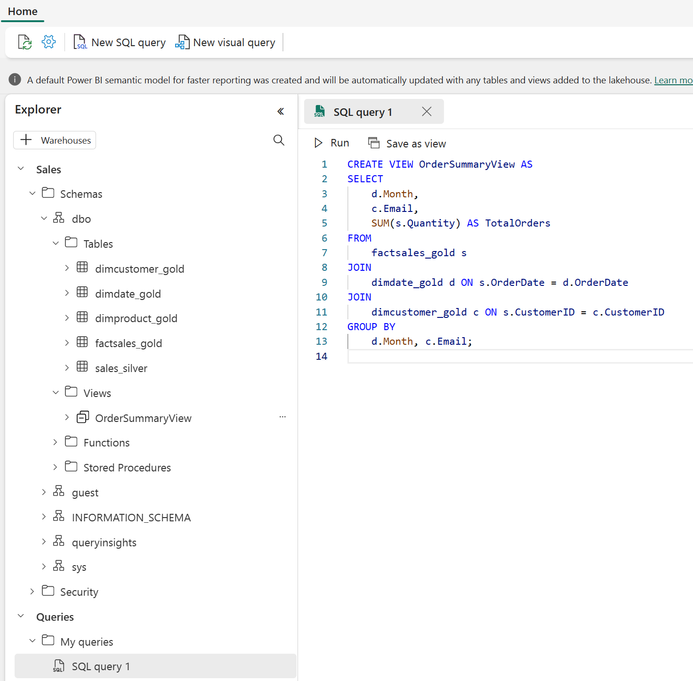
Query data
Use the SQL query editor
Like using SQL Server Management Studio (SSMS) or Azure Data Studio (ADS).
Intellisense
Code completion
Syntax highlighting
Client-side parsing
Validation

Slide 13
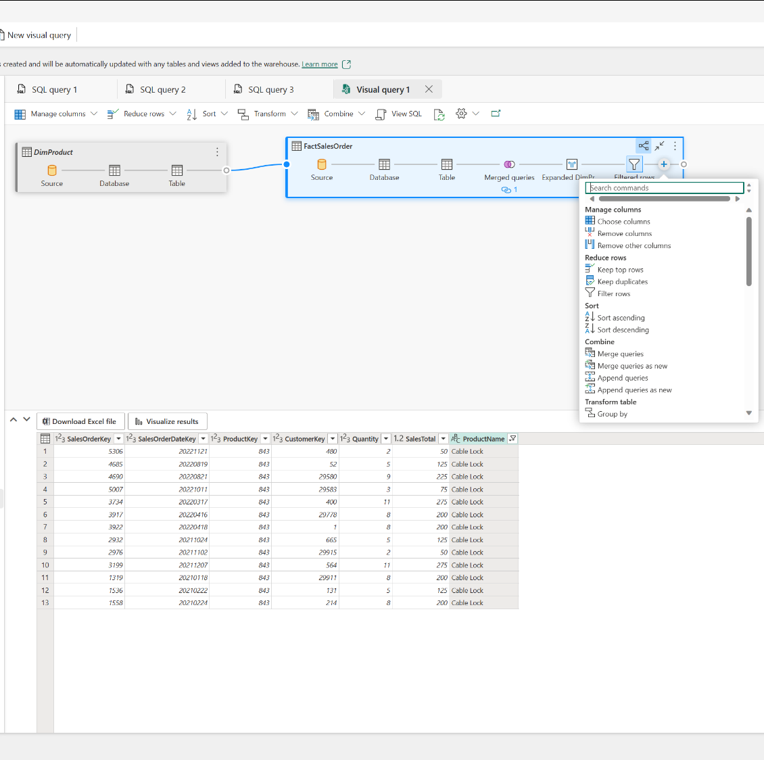
Visualize queries
Create a visual query
Drag table to the canvas, then transform as needed:
Manage columns
Filter rows
Replace values
Group by
And more
Notes:
Similar to using Power Query Editor online.

Slide 14
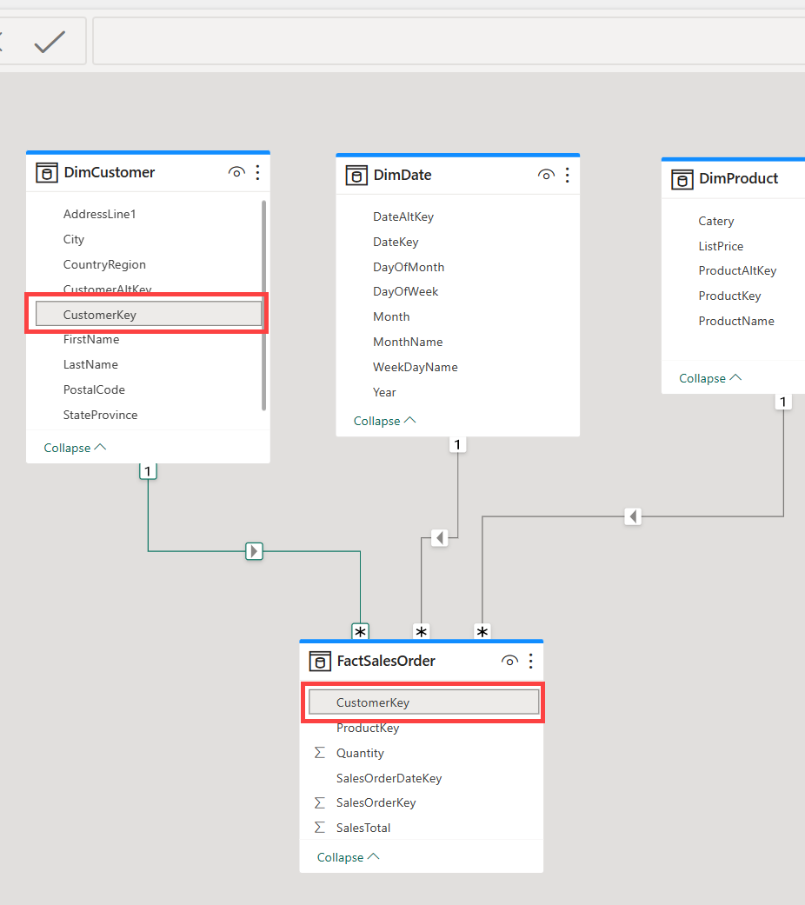
Build relationships
Connect fact and dimension tables
Use Model view in warehouse in Fabric portal.
Identify the appropriate key between tables.
Drag columns from one table on top of the related column in another table.
Notes:
This is the same experience as in Power BI, for those already familiar with that product.

Slide 15
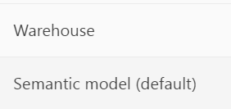
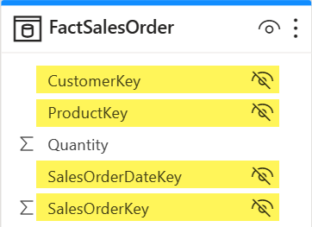
Understand the default semantic model
Fabric automatically creates a default semantic model for Power BI users to use for report creation.
Consider shaping the semantic model to reduce downstream transformations.
User-friendly column names
Hide columns or tables from view
Notes:
Data warehouses are designed to serve prepared data to data analysts.

Slide 16
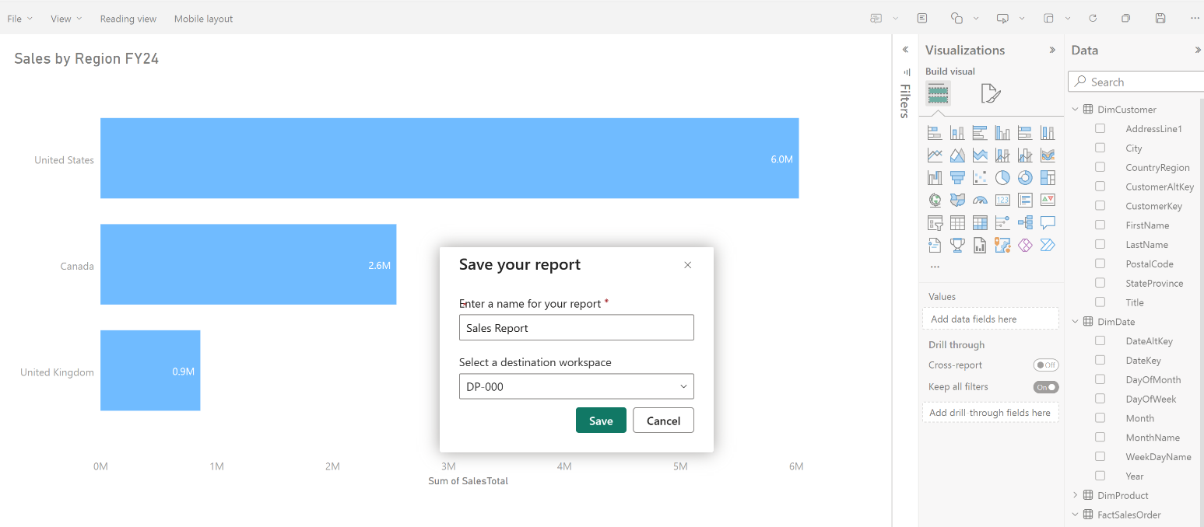
Visualize data
While this task may typically fall to data analysts, it’s valuable to know that you can create Power BI reports directly from within the Fabric warehouse.

Slide 17
Security overview
Role-based access control (RBAC)
SSL encryption
Azure Storage Service Encryption
Azure Monitor and Azure Log Analytics
Multifactor authentication (MFA)
Microsoft Entra ID integration
Notes:
Role-based access control (RBAC) to control access to the warehouse and its data.
SSL encryption to secure the communication between the warehouse and the client applications.
Azure Storage Service Encryption to protect the data in transit and at rest.
Azure Monitor and Azure Log Analytics to monitor the warehouse activity and audit the access to the data.
Multifactor authentication (MFA) to add an extra layer of security to user accounts.
Microsoft Entra ID integration to manage the user identities and access to the warehouse.
More information: https://learn.microsoft.com/en-us/fabric/data-warehouse/security
aka.ms/fabric-admin

Slide 18
Workspace and item permissions
Workspaces
Items
Containers, store related items
Roles grant workspace access
Admin
Contributor
Member
Viewer
Lakehouses, warehouses, semantic models, reports, dashboards, etc.
Item-level access in workspace
SQL analytics endpoint access
Read
ReadData
ReadAll
Notes:
Workspaces are containers used to store and group related items: lakehouses, warehouses, semantic models, Power BI reports, and more.
Items can be granted individual access with a similar permissions experience to OneDrive sharing.
You can grant permissions to users via T-SQL or in the Fabric portal. Grant the following permissions to users who need to access your data warehouse:
Read: Allows the user to CONNECT using the SQL connection string.
ReadData: Allows the user to read data from any table/view within the warehouse.
ReadAll: Allows user to read data the raw parquet files in OneLake that can be consumed by Spark.
A user connection to the SQL endpoint will fail without Read permission at a minimum.

Slide 19
Exercise
Analyze data in a data warehouse
30 minutes
Notes:
https://aka.ms/mslearn-fabric-warehouse The estimated time to complete this exercise is 30 minutes.

Slide 20
Knowledge check
1
Which type of table should an insurance company use to store supplier attribute details for aggregating claims?
Fact table.
Dimension table.
Staging table.
2
What is a dataset in the data warehouse experience?
Datasets are semantic models that are used to create reports.
Datasets are a collection of files that contain unorganized data.
Datasets are a set of variables and observations that haven't been cleaned or preprocessed.
3
What is the purpose of item permissions in a workspace?
To grant access to all items within a workspace.
To grant access to specific columns within a table.
To grant access to individual warehouses for downstream consumption.
Notes:
Allow students a few minutes to think about the questions, and then use the animated slide to reveal the correct answers.

Slide 21
Recap
In this section, we covered:
Data warehouse and dimensional modeling concepts
Creating warehouses and ingest data
Querying and visualizing data
Semantic models and their purpose for downstream reporting
Secure a data warehouse

Slide 22

Further reading
Get started with data warehouses in Microsoft Fabric
https://aka.ms/fabric-warehouse
Notes:
Encourage students to review the online material on Microsoft Learn on which this presentation is based.

Slide 23
Load data into a Microsoft Fabric data warehouse
Notes:
https://aka.ms/fabric-loaddw
Before delivering this presentation, review the associated module on Microsoft Learn.
The estimated time to present these slides is 45 minutes.

Slide 24
Understand ETL (Extract, Transform and Load)
Extract
Connect to source, select necessary data
Transform
Clean, format, deduplicate, combine extracted data
Load
Insert into fact and dimension tables
Post-load optimizations
Apply performance tuning options

Slide 25
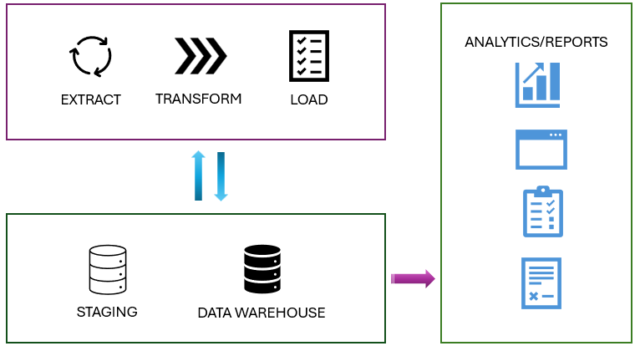
Stage the data
Temporary storage and transformation
Simplifies load operations
Notes:
Data ingestion/extraction moves raw data from various sources into a central repository – a staging location.

Slide 26
Different data load types
Full (initial) load
Incremental load
Truncate table and load data
Longer load time
No history stored
Best for initial load or refresh
Append data to tables
Faster updates
Preserves history (timestamp)
Best for frequent updates
Notes:
Full load:
The process of populating the data warehouse for the first time.
All the tables are truncated and reloaded, and the old data is lost
It may take longer to complete due to the amount of data being handled
Easier to implement as there's no history preserved
This method is typically used when setting up a new data warehouse, or when a complete refresh of the data is required
Incremental load:
The process of updating the data warehouse with the changes since the last update
The history is preserved, and tables are updated with new information
Takes less time than the initial load
Implementation is more complex than the initial load
This method is commonly used for regular updates to the data warehouse, such as daily or hourly updates. It requires mechanisms to track changes in the source data since the last load.

Slide 27
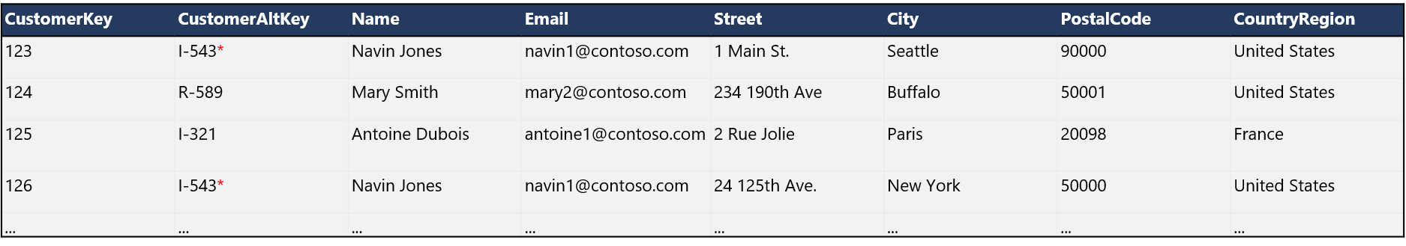
Dimension keys
Surrogate key
Uniquely identifies an instance of a dimension entity (i.e. a row)
Usually a simple integer value
Must be unique in the dimension table
Alternate key
Identifies an entity in the operational source system
Often a business key (e.g. a product code or customer ID) or a natural key (e.g. a datetime value in a time dimension)
Can be duplicated in the dimension table to represent the same entity at different points in time
* This customer moved from Seattle to New York, so a new record with the same alternate key but a new surrogate key was added.
Notes:
Students may need help understanding the difference between surrogate and alternate keys. Surrogate keys only exist in the data warehouse, and are used to uniquely identify each row in a dimension table – essentially, it’s a primary key for the dimension table and is usually implemented as a simple unique integer value. Alternate keys identify a specific instance of a dimension entity (such as a customer) and are often inherited from the source operational system (the “business” key for that entity) or based on a “natural” key that uniquely identifies an entity (such as an email address for a customer). The important point is that the dimension table might need to contain multiple records for a specific entity instance to represent its attributes at different points in time. For example, in the slide there’s a customer named Navin Jones who at some point moved from Seattle to New York. The table contains two records for this customer so that when aggregating sales by city, sales to the customer are counted for the city of residence at the time of the sale – it’s the same customer, so the alternate key is the same for both records, but the surrogate key enables us to maintain a separate record for each city where they’ve lived.
Note that the example on the slide is simplistic. It’s common for “slowly changing dimensions” like this to include columns to indicate the effective dates for each record and a flag to indicate which record for a given alternate key represents the “current” version of that entity.

Slide 28
Create tables with T-SQL
SQL Server Management Studio
Microsoft Fabric service portal
CREATE TABLE DimProduct (
ProductID INT PRIMARY KEY,
ProductName NVARCHAR(100),
CategoryID INT,
Price DECIMAL(10, 2)
);

Slide 29
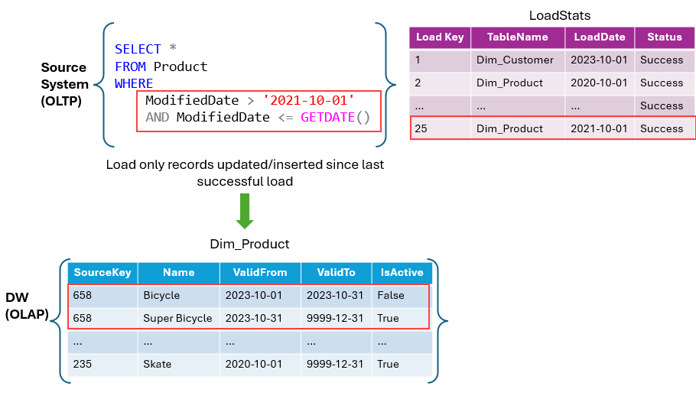
Load dimension tables
Slowly changing dimension types
0: never changes
1: overwrites, no history
2: appends, tracks changes
3: add history column
4: add new dimension
5: like type 2 for large changes
6: combo of types 2 and 3
Notes:
Think of a dimension table as the "who, what, where, when, why” of your data warehouse.
Slowly changing dimensions (SCD)
Slowly Changing Dimensions change over time, but at a slow pace and unpredictably. For example, a customer’s address in a retail business. When a customer moves, their address changes. If you overwrite the old address with the new one, you lose the history. But if you want to analyze historical sales data, you might need to know where the customer lived at the time of each sale. This is where SCDs come into play.
There are several types of slowly changing dimensions in a data warehouse, with type 1 and type 2 being the most frequently used.
Type 0 SCD: The dimension attributes never change.
Type 1 SCD: Overwrites existing data, doesn't keep history.
Type 2 SCD: Adds new records for changes, keeps full history for a given natural key.
Type 3 SCD: History is added as a new column.
Type 4 SCD: A new dimension is added.
Type 5 SCD: When certain attributes of a large dimension change over time, but using type 2 isn't feasible due to the dimension’s large size.
Type 6 SCD: Combination of type 2 and type 3.

Slide 30
Example
IF EXISTS (SELECT 1 FROM Dim_Products WHERE SourceKey = @ProductID AND IsActive = 'True')
BEGIN
-- Existing product record
UPDATE Dim_Products
SET ValidTo = GETDATE(), IsActive = 'False'
WHERE SourceKey = @ProductID AND IsActive = 'True';
END
ELSE
BEGIN
-- New product record
INSERT INTO Dim_Products (SourceKey, ProductName, StartDate, EndDate, IsActive)
VALUES (@ProductID, @ProductName, GETDATE(), '9999-12-31', 'True');
END
Update table Dim_Products, designed as a Type 2 SCD.
Notes:
In type 2 SCD, when a new version of the same element is brought to the data warehouse, the old version is considered expired and the new one becomes active.
Here we have an example of how to update a
The mechanism for detecting changes in source systems is crucial for determining when records are created, inserted, updated, or deleted (CRUD).

Slide 31
Load fact tables
INSERT INTO dbo.FactSales
SELECT (SELECT MAX(DateKey)
FROM dbo.DimDate
WHERE FullDateAlternateKey = stg.OrderDate) AS OrderDateKey,
(SELECT MAX(CustomerKey)
FROM dbo.DimCustomer
WHERE CustomerAlternateKey = stg.CustNo) AS CustomerKey,
(SELECT MAX(ProductKey)
FROM dbo.DimProduct
WHERE ProductAlternateKey = stg.ProductID) AS ProductKey,
(SELECT MAX(StoreKey)
FROM dbo.DimStore
WHERE StoreAlternateKey = stg.StoreID) AS StoreKey,
OrderNumber,
OrderLineItem,
OrderQuantity,
UnitPrice,
Discount,
Tax,
SalesAmount
FROM dbo.StageSales AS stg
Use an INSERT statement
Look up surrogate keys in dimension tables based on alternate key:
Simple case, get the most recently loaded dimension instance (maximum incrementing surrogate key)
Or use an IsCurrent flag field
Or use start and end dates to find the right instance for the fact time
Notes:
The key challenge in loading fact tables is the need to look up the correct surrogate keys for each row. Typically, the staged data will include the alternate (business or natural) key, but you need to use the surrogate key in the fact table so that each row is related to the correct instance of each dimension for the time at which the fact occurred. In the code example on the slide, an assumption is made that the fact records being loaded all relate to the latest versions of all dimensions, and that each dimension table uses an incrementing surrogate key (so the code looks up the highest surrogate key value for each alternate key). In some cases, the logic to find the right surrogate key may be more complex (for example, in this case you might need to use the OrderDate to find the appropriate DimCustomer record for the customer alternate key on the date the order was placed).
Point out to students that the need to look up the dimension surrogate key means that in most data warehouse load processes, dimension tables must be loaded before fact tables.

Slide 32
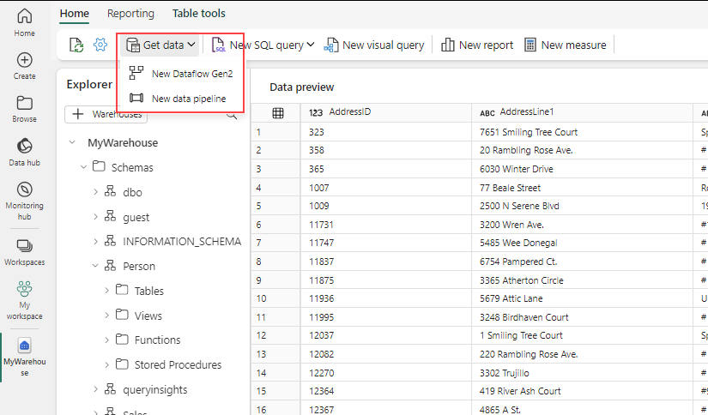
Load data with Fabric pipelines
Orchestrate activities
Copy Data
Schedule
Parameters
Delete Data
Notes:
Pipelines offer many different activities for orchestrating data movement. However, the most common uses for loading data into a warehouse will be Copy Data and possibly schedule, parameters, and delete data, depending on load type.

Slide 33
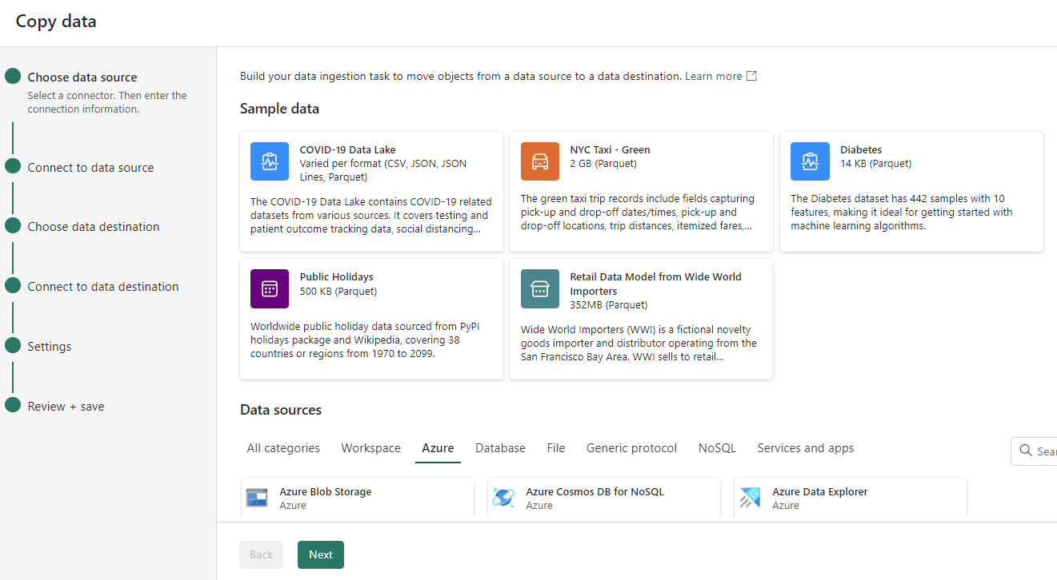
Configure the copy data assistant
Choose data source
Connect to a data source
Choose data destination
Connect to data destination
Settings
Notes:
Choose data source: Select a connector, and provide the connection information.
Connect to a data source: Select, preview, and choose the data. This can be done from tables or views, or you can customize your selection by providing your own query.
Choose data destination: Select the data store as the destination.
Connect to data destination: Select and map columns from source to destination. You can load to a new or existing table.
Settings: Configure other settings like staging, and default values.

Slide 34
Load data with T-SQL
-- Load as CSV
COPY INTO my_table
FROM 'https://myaccount.blob.core.windows.net/myblobcontainer/folder0/*.csv, https://myaccount.blob.core.windows.net/myblobcontainer/folder1/'
WITH (FILE_TYPE = 'CSV',
CREDENTIAL=(IDENTITY= 'Shared Access Signature', SECRET='<Your_SAS_Token>’),
FIELDTERMINATOR = '|’)
-- Load as PARQUET
COPY INTO test_parquet
FROM
'https://myaccount.blob.core.windows.net/myblobcontainer/folder1/*.parquet'
WITH (CREDENTIAL=(IDENTITY= 'Shared Access Signature', SECRET='<Your_SAS_Token>'))
Use COPY statement
External Azure storage
Specify file format (PARQUET / CSV)
Error handling
Multiple files
Notes:
The COPY statement serves as the main method for importing data into the Warehouse. It facilitates efficient data ingestion from an external Azure storage account.
It offers flexibility, allowing you to specify the format of the source file, designate a location for storing rows that are rejected during the import process, skip header rows, among other configurable options.
The option to store rejected rows separately is useful for data cleaning and quality control. It allows you to easily identify and investigate any issues with the data that weren't successfully imported.
The option to use a different storage account for the ERRORFILE location (REJECTED_ROW_LOCATION) allows for better error handling and debugging. It makes it easier to isolate and investigate any issues that occur during the data loading process. ERRORFILE only applies to CSV.
The ability to specify wildcards and multiple files in the storage location path allows the COPY statement to handle bulk data loading efficiently. This is useful when dealing with large datasets distributed across multiple files.

Slide 35
Load from other assets
CREATE TABLE [analysis_warehouse].[dbo].[combined_data]
AS
SELECT
FROM [sales_warehouse].[dbo].[sales_data] sales
INNER JOIN [social_lakehouse].[dbo].[social_data] social
ON sales.[product_id] = social.[product_id];
INSERT INTO [analysis_warehouse].[dbo].[combined_data]
SELECT
sales.product_id
FROM [sales_warehouse].[dbo].[sales_data] sales
INNER JOIN [social_lakehouse].[dbo].[social_data] social
ON sales.product_id = social.product_id;
Combine into one warehouse
Requires three-part-naming
CREATE TABLE AS SELECT
INSERT…SELECT
Notes:
You can load data from various items in a workspace, such as other warehouses and lakehouses.
In a scenario where an analyst needs data from both a warehouse and a lakehouse, they can use this feature to combine the data. They can then load this combined data into the warehouse for analysis. This feature is useful when data is distributed across many assets in a workspace.
All the Warehouses that share the same workspace are integrated into the same logical SQL server. If you use SQL client tools such as SQL Server Management Studio, you can easily perform a cross-database query like in any SQL Server instance.
If you’re using the object Explorer from the workspace to query your Warehouses, you need to add them explicitly. The warehouses added will also be visible from the Visual query editor.

Slide 36
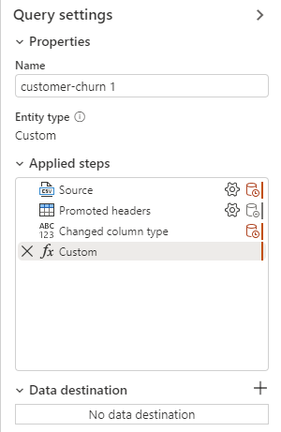
Load data with Dataflows Gen2
Ingest and transform with Power Query
Connect to data source
Append or replace
Add data destination
Lakehouse
Warehouse
Azure SQL Database
Azure Data Explorer (Kusto)
Azure Synapse Analytics (SQL DW)
Publish
Notes:
Once the data is imported you can start authoring your dataflow, you might decide to clean your data, reshape, remove columns, and create new ones. All the steps you perform are saved.
With the Add data destination feature, you can separate your ETL logic and destination storage. This separation can lead to cleaner, more maintainable code and can make it easier to modify either the ETL process or the storage configuration without affecting the other.
When you select a warehouse as a destination, you can choose the following update methods.
Append: Add new rows to an existing table.
Replace: Replace the entire content of a table with a new set of data.

Slide 37
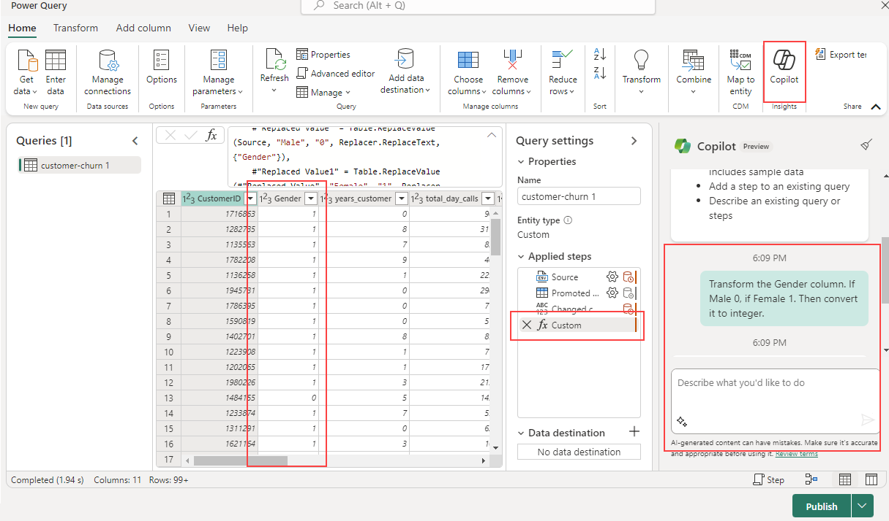
Transform data with Copilot
Example:
Let's say we have a Gender column that contains ‘Male’ and ‘Female’, and we want to transform it to integer.
Notes:
Transform data with Copilot
Copilot can be a valuable tool for assisting with dataflow transformations. The first step is to activate Copilot within your dataflow. Once that's done, you can then provide specific instructions on the transformation you want to perform.
For instance, you might input the following command: "Transform the Gender column. If Male 0, if Female 1. Then convert it to integer."

Slide 38
Exercise
Load data into a data warehouse in Microsoft Fabric
30 minutes
Notes:
https://aka.ms/mslearn-fabric-warehouse-load
The estimated time to complete this exercise is 30 minutes.

Slide 39
Knowledge check
1
What are the four data ingestion options available in Microsoft Fabric for loading data into a data warehouse?
COPY (Transact-SQL) statement, data pipelines, dataflows, and cross-warehouse.
COPY (Transact-SQL) statement, data pipelines, dataflows, and Data Wrangler.
COPY (Transact-SQL) statement, data pipelines, dataflows, and cross-platform ingestion.
2
What are the supported data sources and file formats for the COPY (Transact-SQL) statement in Warehouse?
Azure Data Lake Storage (ADLS) Gen2 and Azure Blob Storage, with PARQUET and CSV file formats.
Azure Data Lake Storage (ADLS) Gen1 and Azure Blob Storage, with PARQUET and CSV file formats.
Azure Data Lake Storage (ADLS) Gen2 and Azure Blob Storage, with ORC and CSV file formats.
3
What is the recommended minimum file size when working with external data on files in Microsoft Fabric?
At least 4 MB.
At least 1 MB.
At least 10 MB.
Notes:
Allow students a few minutes to think about the questions, and then use the animated slide to reveal the correct answers.

Slide 40
Recap
In this section, we covered:
Different strategies to load data into a data warehouse
How to build a data pipeline to load a warehouse
How to load data in a warehouse using T-SQL.
How to load and transform data with dataflows Gen2.

Slide 41
Further reading
Load data into a Microsoft Fabric data warehouse
https://aka.ms/fabric-loaddw
Notes:
Encourage students to review the online material on Microsoft Learn on which this presentation is based.

Slide 42
Query a data warehouse in Microsoft Fabric
Notes:
https://aka.ms/fabric-querydw
Before delivering this presentation, review the associated module on Microsoft Learn.
The estimated time to present these slides is 45 minutes.

Slide 43
Aggregate measures by dimension attributes
Aggregates numeric measures from fact tables
Uses JOIN clauses to link dimension tables
Employs aggregate functions and GROUP BY clauses
SELECT dates.CalendarYear,
dates.CalendarQuarter,
SUM(sales.SalesAmount) AS TotalSales
FROM dbo.FactSales AS sales
JOIN dbo.DimDate AS dates ON sales.OrderDateKey = dates.DateKey
GROUP BY dates.CalendarYear, dates.CalendarQuarter
ORDER BY dates.CalendarYear, dates.CalendarQuarter;
Notes:
In most data analytics scenarios involving a data warehouse, the process typically revolves around aggregating numeric measures from fact tables based on attributes in dimension tables. Due to the structure of a star or snowflake schema, such aggregation queries depend on `JOIN` clauses to link fact tables with dimension tables. Also, they use aggregate functions and `GROUP BY` clauses to define the aggregation hierarchies.

Slide 44
Joins in a snowflake schema
Partially normalized dimensions
Multiple joins to relate fact tables
SELECT cat.ProductCategory,
SUM(sales.OrderQuantity) AS ItemsSold
FROM dbo.FactSales AS sales
JOIN dbo.DimProduct AS prod ON sales.ProductKey = prod.ProductKey
JOIN dbo.DimCategory AS cat ON prod.CategoryKey = cat.CategoryKey
GROUP BY cat.ProductCategory
ORDER BY cat.ProductCategory;
Notes:
When using a snowflake schema, dimensions may be partially normalized; requiring multiple joins to relate fact tables to snowflake dimensions. For example, suppose your data warehouse includes a DimProduct dimension table from which the product categories have been normalized into a separate DimCategory table.

Slide 45
Use ranking functions
SELECT ProductCategory,
ProductName,
ListPrice,
ROW_NUMBER() OVER
(PARTITION BY ProductCategory ORDER BY ListPrice DESC) AS RowNumber,
RANK() OVER
(PARTITION BY ProductCategory ORDER BY ListPrice DESC) AS Rank,
DENSE_RANK() OVER
(PARTITION BY ProductCategory ORDER BY ListPrice DESC) AS DenseRank,
NTILE(4) OVER
(PARTITION BY ProductCategory ORDER BY ListPrice DESC) AS Quartile
FROM dbo.DimProduct
ORDER BY ProductCategory;
ROW_NUMBER: Ordinal position within partition
RANK: Ranked position, ties included
DENSE_RANK: Ranked position, ties ignored
NTILE: Percentile of row within partition
Notes:
Another common kind of analytical query is to partition the results based on a dimension attribute and *rank* the results within each partition. For example, you might want to rank stores each year by their sales revenue. To accomplish this goal, you can use Transact-SQL *ranking* functions such as `ROW_NUMBER`, `RANK`, `DENSE_RANK`, and `NTILE`. These functions enable you to partition the data over categories, each returning a specific value that indicates the relative position of each row within the partition.
ROW_NUMBER returns the ordinal position of the row within the partition. For example, the first row is numbered 1, the second 2, and so on.
RANK returns the ranked position of each row in the ordered results. For example, in a partition of stores ordered by sales volume, the store with the highest sales volume is ranked 1. If multiple stores have the same sales volumes, they'll be ranked the same, and the rank assigned to subsequent stores reflects the number of stores that have higher sales volumes - including ties.
DENSE_RANK ranks rows in a partition the same way as RANK, but when multiple rows have the same rank, subsequent rows are ranking positions ignore ties.
NTILE returns the specified percentile in which the row falls. For example, in a partition of stores ordered by sales volume, NTILE(4) returns the quartile in which a store's sales volume places it.
The query in the example partitions products into groupings based on their categories, and within each category partition, the relative position of each product is determined based on its list price.

Slide 46
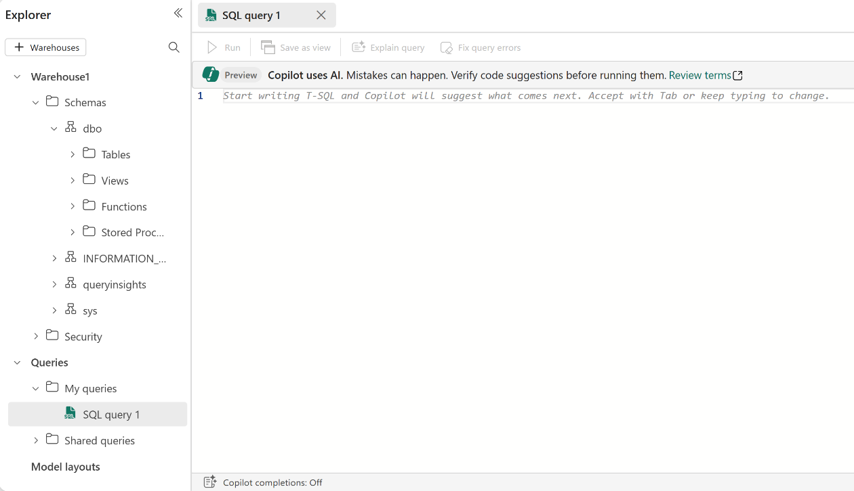
Use the SQL query editor
Warehouse explorer in Fabric portal
Use T-SQL
Supports Intellisense
Stores in My queries
Notes:
The SQL query editor in Microsoft Fabric is a versatile tool that supports Transact-SQL (T-SQL), allowing you to create and run scripts to query your data warehouse. It also provides features such as IntelliSense and debugging to aid in the development process.
T-SQL allows users, analysts and developers to manipulate the data stored in a warehouse.
Launch a SQL query editor
The SQL query editor isn't just about querying; it’s about managing your data effectively. Whether you’re creating a new table, inserting rows into a table, granting objects permission or executing complex queries, the SQL query editor is designed to make these tasks seamless.
To launch the SQL query editor, you need to select your warehouse asset from My workspace. This step connects to your data warehouse automatically, without you having to prompt any connection information.
From the warehouse Explorer, there are a few ways to create a SQL query editor.
Home menu: Select New SQL query or select any of the templates available.
Queries node: Select ... in My queries, then select New SQL Query.
Query tab: This option opens a new query editor.
No matter how you initiate a new query editor, a new query item is automatically created in My queries folder in the Explorer.
Any new query item updated is automatically saved.

Slide 47
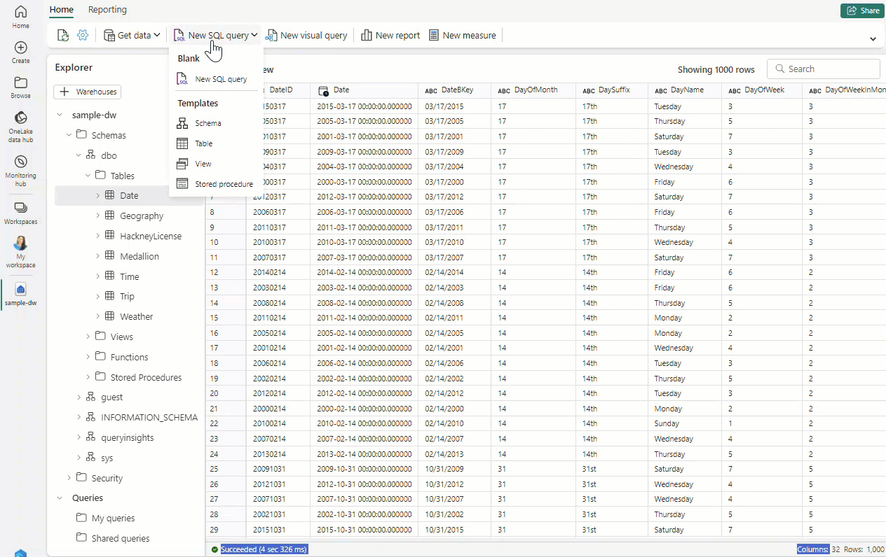
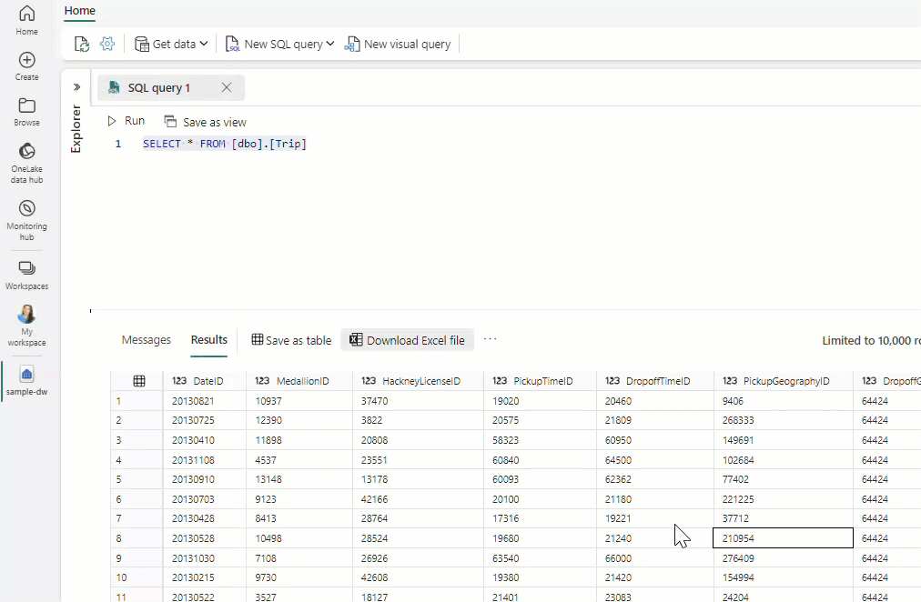
Run queries and export results
Run and save results as view
Download as Excel file
Notes:
The Results section shows a preview, limited to 10,000 rows if exceeded.
Your query results can be exported as an Excel file.
The query editor offers the ability to save your highlighted query as either a view or a table, each with distinct features:
Save as view: Allows you to create a view in the warehouse using the SELECT statement highlighted in the query editor.
Save as table: Creates a new table with your query results.
For both options, you must provide the schema and the name before confirming the creation.

Slide 48
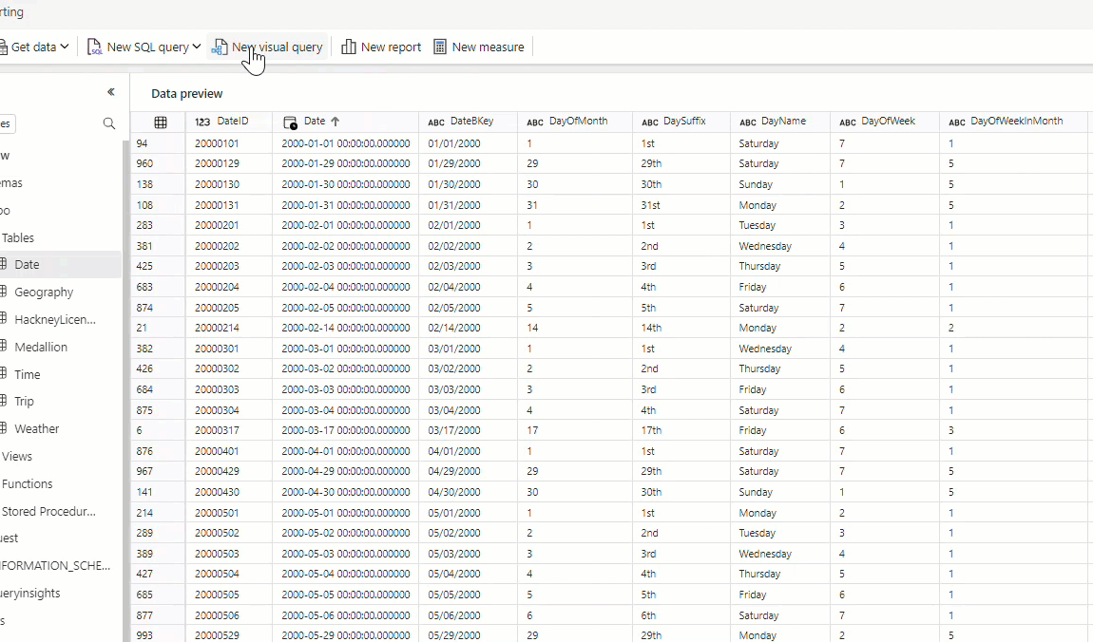
Explore visual query editor
Visually build queries
Graphical interface
Automatic query generation
Save as table/view
Notes:
The visual query editor enhances intuitive understanding of data relationships by allowing users to visually organize tables and fields.
Also, the visual query editor is user-friendly, even for those with little to no SQL experience. Nontechnical team members can use it to extract valuable insights from your data, democratizing data access within your organization and speeding up the decision-making process.
Limitations with visual query editor
In the visual query editor, you can only run DQL (Data Query Language) or read-only SELECT statements. DDL or DML statements are not supported.
Only a subset of Power Query operations that support Query folding are currently supported.
Visualize Results currently does not support SQL queries with an ORDER BY clause.
https://learn.microsoft.com/en-us/fabric/data-warehouse/visual-query-editor

Slide 49
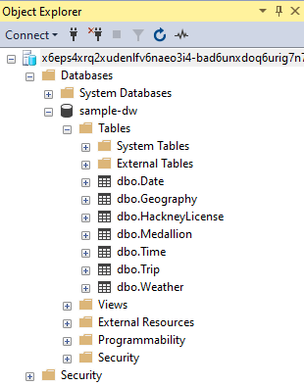
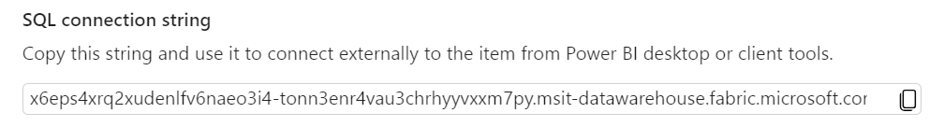
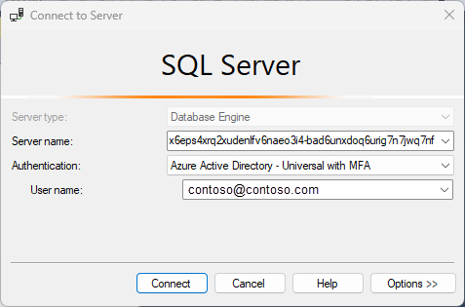
Connect with SQL clients
Notes:
In the Fabric service, navigate to the warehouse item, select settings, then copy the SQL connection string.
Use your preferred SQL client tool – this screenshot shows SQL Management Studio (SSMS) – and connect with appropriate authentication.
In Microsoft Fabric, two types of authenticated users are supported through the SQL connection string:
Microsoft Entra ID (formerly Azure Active Directory) user principals, or user identities
Microsoft Entra ID (formerly Azure Active Directory) service principals
Any third-party tool can use the SQL connection string via ODBC or OLE DB drivers to connect to a Microsoft Fabric Warehouse or SQL analytics endpoint, using Microsoft Entra ID (formerly Azure Active Directory) authentication.

Slide 50
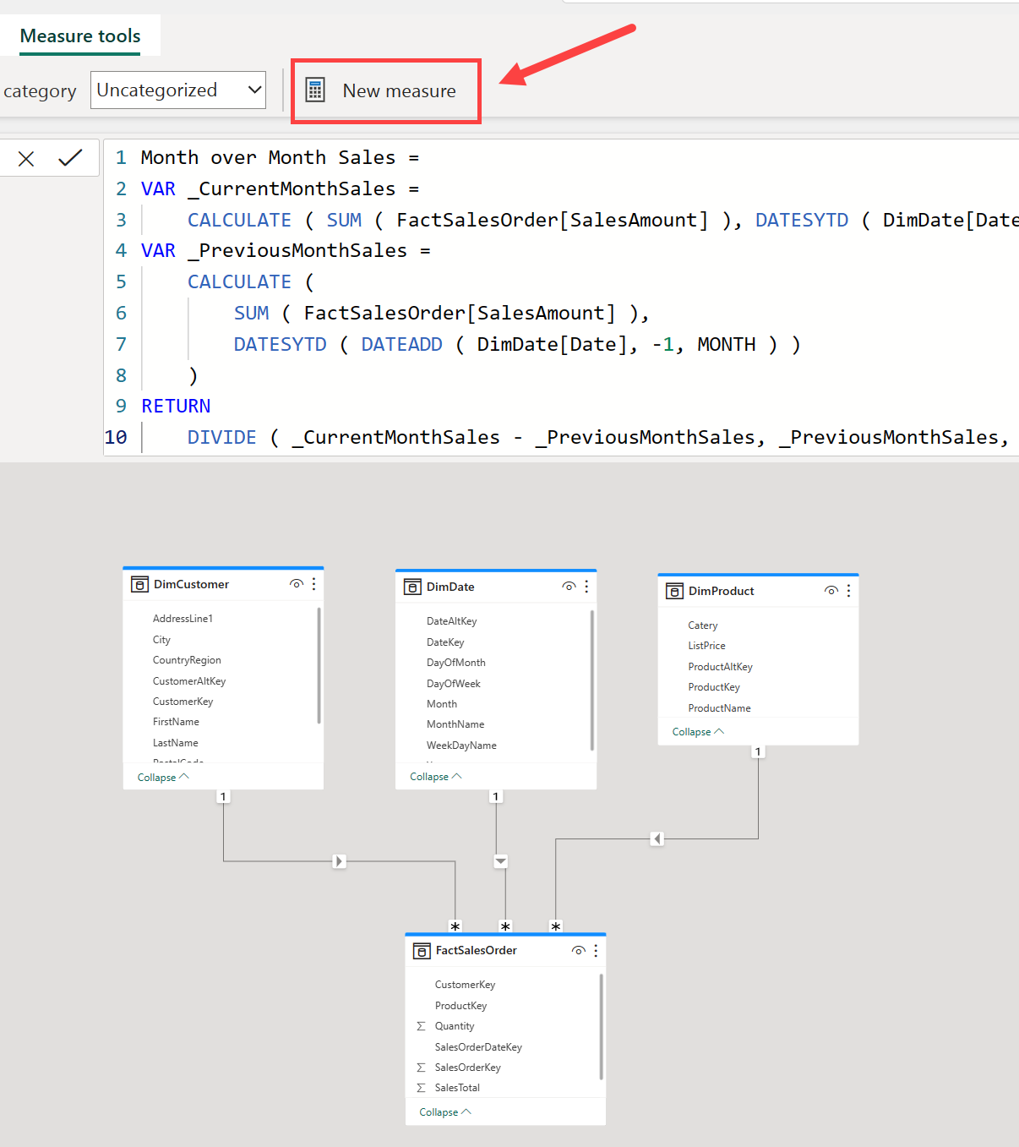
DAX calculations
Use DAX to create measures
Create same calculations as with T-SQL
Hundreds of functions
Contextual calculations
As complex as needed
Notes:
DAX is out of scope for this course; however, those familiar with building semantic models in Power BI Desktop will feel very comfortable using this feature if needed.

Slide 51
Aggregate measures
Use T-SQL to create measures
-- Sales amounts by year and quarter
SELECT dates.CalendarYear,
dates.CalendarQuarter,
SUM(sales.SalesAmount) AS TotalSales
FROM dbo.FactSales AS sales
JOIN dbo.DimDate AS dates
ON sales.OrderDateKey = dates.DateKey
GROUP BY dates.CalendarYear, dates.CalendarQuarter
ORDER BY dates.CalendarYear, dates.CalendarQuarter;
Traditional SQL data warehouses relied on T-SQL to create measures. Common functions are:
JOIN
GROUP BY
Notes:
Most data analytics with a data warehouse involves aggregating numeric measures in fact tables by attributes in dimension tables.
Because of the way a star or snowflake schema is implemented, queries to perform this kind of aggregation rely on JOIN clauses to connect fact tables to dimension tables, and a combination of aggregate functions and GROUP BY clauses to define the aggregation hierarchies.

Slide 52
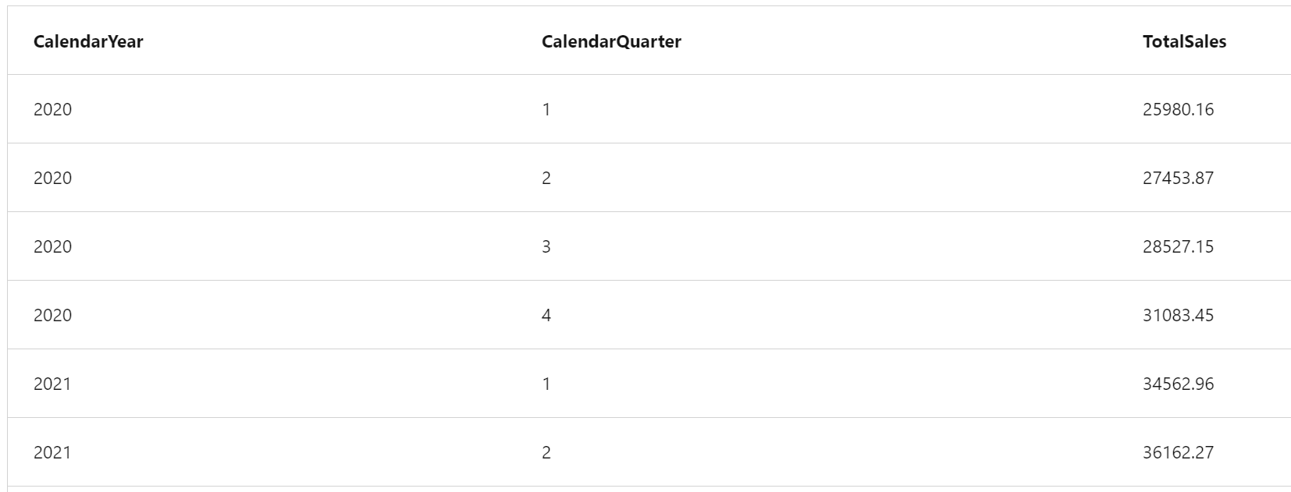
Output – total sales by year and quarter
Notes:
Most data analytics with a data warehouse involves aggregating numeric measures in fact tables by attributes in dimension tables.
Because of the way a star or snowflake schema is implemented, queries to perform this kind of aggregation rely on JOIN clauses to connect fact tables to dimension tables, and a combination of aggregate functions and GROUP BY clauses to define the aggregation hierarchies.

Slide 53
Extend measures
-- Quarterly total sales by customer city
SELECT dates.CalendarYear,
dates.CalendarQuarter,
custs.City,
SUM(sales.SalesAmount) AS TotalSales
FROM dbo.FactSales AS sales
JOIN dbo.DimDate AS dates ON sales.OrderDateKey = dates.DateKey
JOIN dbo.DimCustomer AS custs ON sales.CustomerKey = custs.CustomerKey
GROUP BY dates.CalendarYear, dates.CalendarQuarter, custs.City
ORDER BY dates.CalendarYear, dates.CalendarQuarter, custs.City;
Building from last example
Further explores the quarterly sales totals by city based on the customer's address details.
Notes:
Most data analytics with a data warehouse involves aggregating numeric measures in fact tables by attributes in dimension tables.
Because of the way a star or snowflake schema is implemented, queries to perform this kind of aggregation rely on JOIN clauses to connect fact tables to dimension tables, and a combination of aggregate functions and GROUP BY clauses to define the aggregation hierarchies.

Slide 54
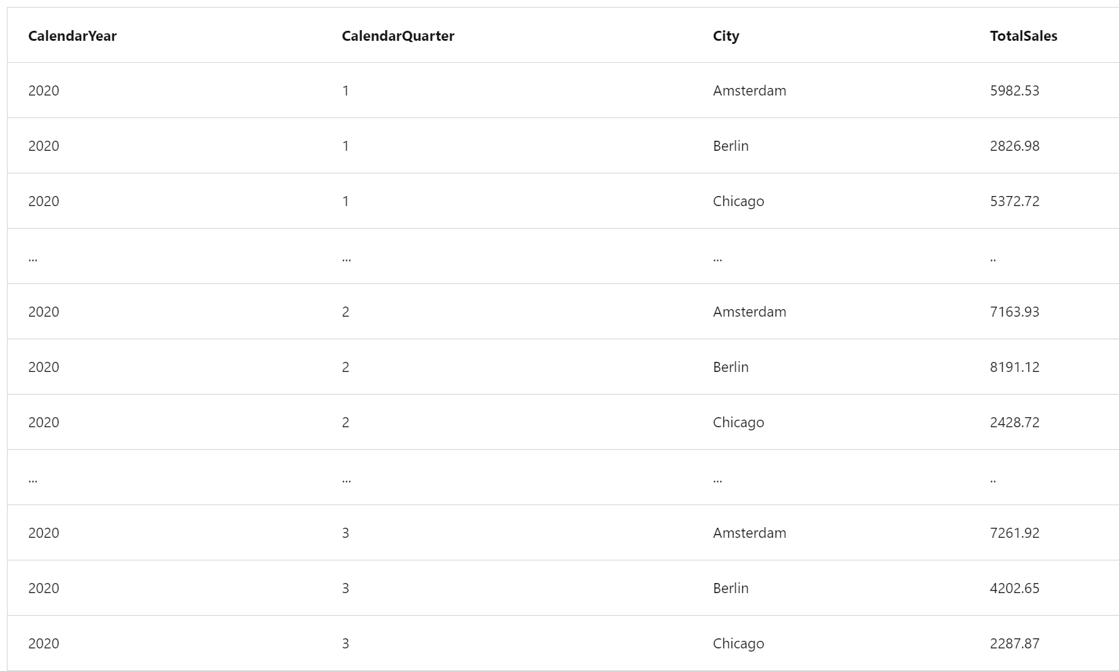
Output – quarterly total sales by city
Notes:
Most data analytics with a data warehouse involves aggregating numeric measures in fact tables by attributes in dimension tables.
Because of the way a star or snowflake schema is implemented, queries to perform this kind of aggregation rely on JOIN clauses to connect fact tables to dimension tables, and a combination of aggregate functions and GROUP BY clauses to define the aggregation hierarchies.

Slide 55
Join in a snowflake schema
-- Items sold by product category
SELECT cat.ProductCategory,
SUM(sales.OrderQuantity) AS ItemsSold
FROM dbo.FactSales AS sales
JOIN dbo.DimProduct AS prod ON sales.ProductKey = prod.ProductKey
JOIN dbo.DimCategory AS cat ON prod.CategoryKey = cat.CategoryKey
GROUP BY cat.ProductCategory
ORDER BY cat.ProductCategory;
Fact to extended dimension
This example joins FactSales and the DimProduct and DimCategory dimension tables, which requires two joins to complete.
Notes:
Most data analytics with a data warehouse involves aggregating numeric measures in fact tables by attributes in dimension tables.
Because of the way a star or snowflake schema is implemented, queries to perform this kind of aggregation rely on JOIN clauses to connect fact tables to dimension tables, and a combination of aggregate functions and GROUP BY clauses to define the aggregation hierarchies.

Slide 56
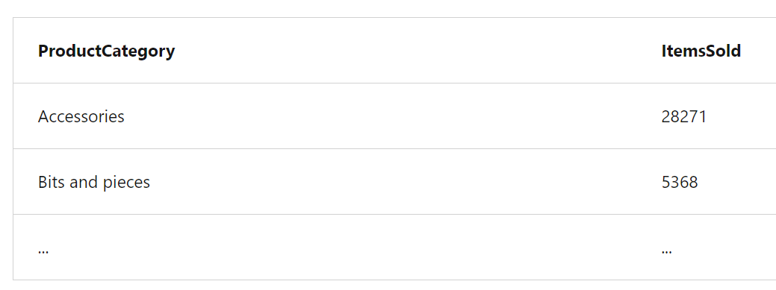
Output – items sold by product category

Slide 57
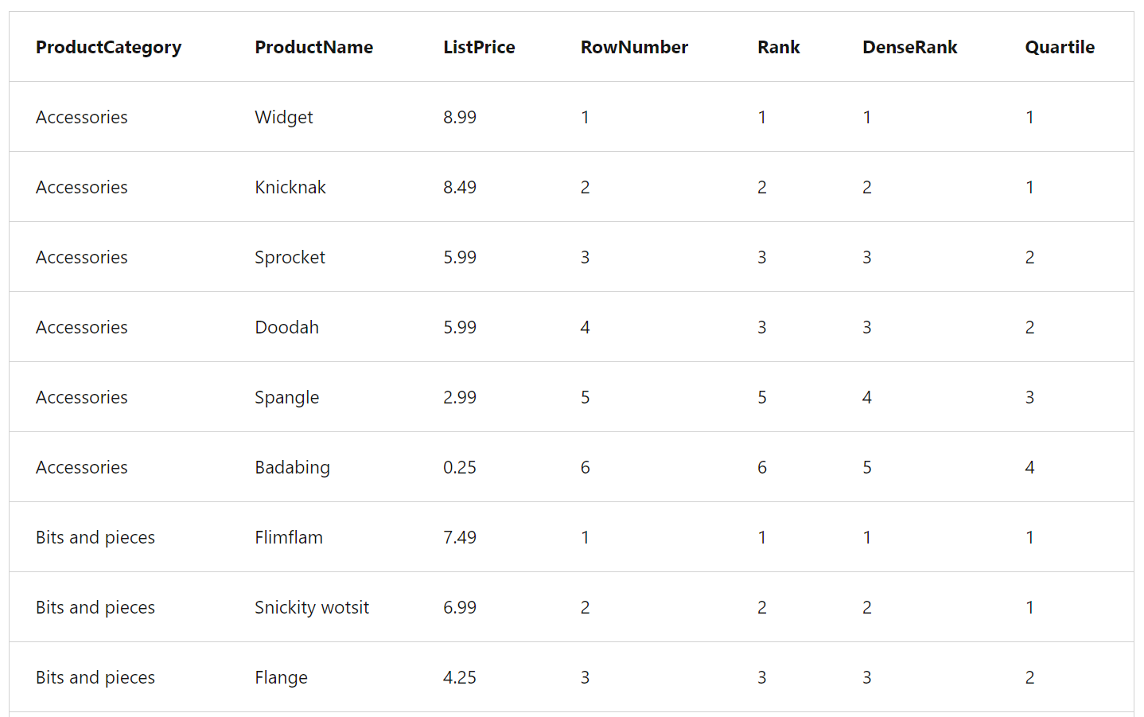
Output – Group by category and relative rank
Notes:
The sample results demonstrate the difference between RANK and DENSE_RANK.
Note that in the Accessories category, the Sprocket and Doodah products have the same list price; and are both ranked as the 3rd highest priced product. The next highest priced product has a RANK of 5 (there are four products more expensive than it) and a DENSE_RANK of 4 (there are three higher prices).

Slide 58
Exercise
Query a data warehouse in Microsoft Fabric
30 minutes
Notes:
https://aka.ms/mslearn-fabric-warehouse-query
The estimated time to complete this exercise is 30 minutes.

Slide 59
Knowledge check
1
What is the primary language used for querying a data warehouse?
Python
T-SQL
C#
2
Why is indexing important in a data warehouse?
It makes the data warehouse look more organized.
It speeds up data retrieval times.
It helps in cleaning the data.
3
What is the purpose of a fact table in a data warehouse?
To store raw data.
To store the results of calculations.
To store metadata about the data warehouse.
Notes:
Allow students a few minutes to think about the questions, and then use the animated slide to reveal the correct answers.

Slide 60
Recap
In this section, we covered:
Using the SQL query editor.
How visual query editor works.
Querying with SQL Server Management Studio.

Slide 61
Further reading
Get started with data warehouses in Microsoft Fabric
https://aka.ms/fabric-warehouse
Notes:
Encourage students to review the online material on Microsoft Learn on which this presentation is based.

Slide 62
Monitor a Microsoft Fabric data warehouse
Notes:
https://aka.ms/fabric-monitordw
Before delivering this presentation, review the associated module on Microsoft Learn.
The estimated time to present these slides is 45 minutes.

Slide 63
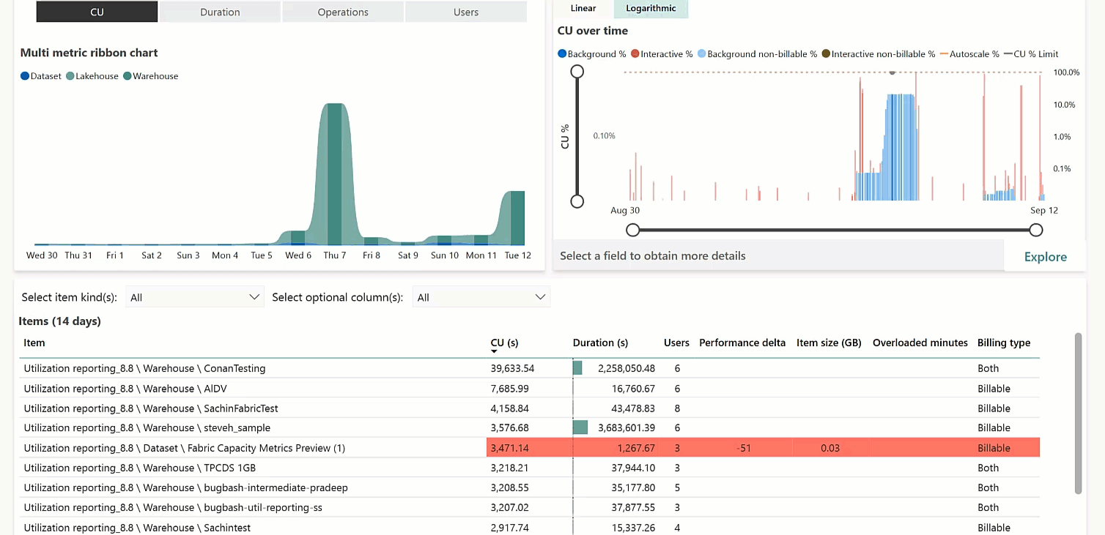
Monitor capacity metrics
Fabric Capacity Metrics app
Monitor and manage workload costs
Requires admin install
Filter by activity type
Tracks Capacity Units (CUs)
Primarily Read/writes
Notes:
By using the Fabric Capacity Metrics app, you can observe capacity utilization trends to determine what processes are consuming CUs in your Fabric environment and whether any throttling is occurring (which indicates that your processes require more capacity than is available within the constraints of your purchased capacity license). With this information, you can optimize your capacity license for your needs.
https://learn.microsoft.com/fabric/data-warehouse/usage-reporting

Slide 64
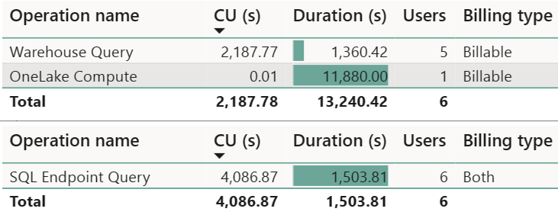
Warehouse operation categories
Warehouse Query
SQL analytics endpoint Query
OneLake Compute
Notes:
By using the Fabric Capacity Metrics app, you can observe capacity utilization trends to determine what processes are consuming CUs in your Fabric environment and whether any throttling is occurring (which indicates that your processes require more capacity than is available within the constraints of your purchased capacity license). With this information, you can optimize your capacity license for your needs.
Both the Warehouse and SQL analytics endpoint rollup under Warehouse in the Metrics app, as they both use SQL compute. The operation categories seen in this view are:
Warehouse Query: Compute charge for all user-generated and system-generated T-SQL statements within a Warehouse.
SQL analytics endpoint Query: Compute charge for all user generated and system generated T-SQL statements within a SQL analytics endpoint.
OneLake Compute: Compute charge for all reads and writes for data stored in OneLake.

Slide 65
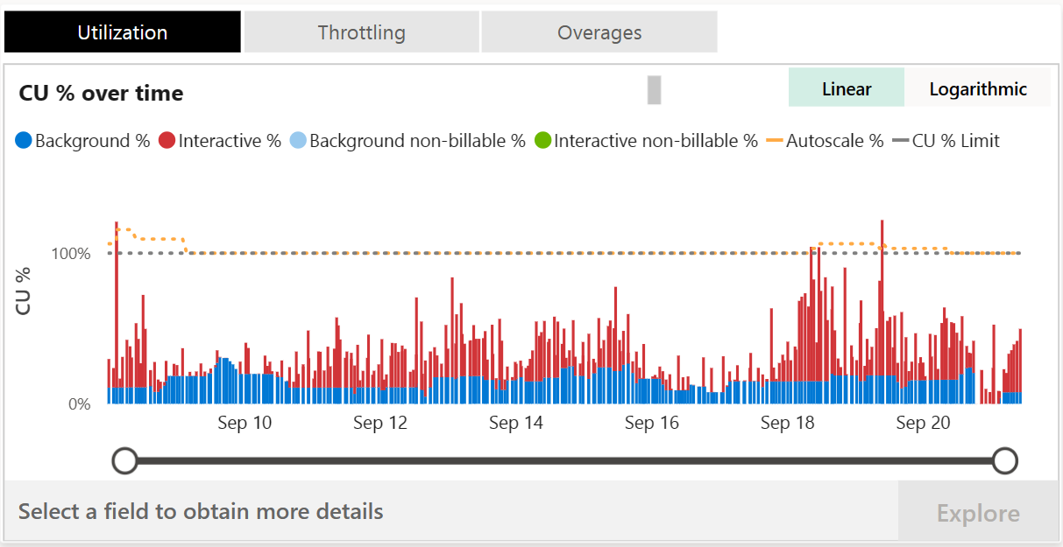
Timepoint explore graph
Notes:
This graph in the Microsoft Fabric Capacity Metrics app shows utilization of resources compared to capacity purchased. 100% of utilization represents the full throughput of a capacity SKU and is shared by all Fabric experiences. This is represented by the yellow dotted line. Selecting a specific timepoint in the graph enables the Explore button, which opens a detailed drill through page.
In general, similar to Power BI, operations are classified either as interactive or background, and denoted by color. Most operations in Warehouse category are reported as background to take advantage of 24-hour smoothing of activity to allow for the most flexible usage patterns. Classifying data warehousing as background reduces the frequency of peaks of CU utilization from triggering throttling.

Slide 66
Usage considerations
Cross-database reporting
System catalog and dynamic management view queries
The ‘Duration(s)’ field in the Fabric Capacity Metrics App
Notes:
Cross-database reporting: Usage is reported against the resource initiating a T-SQL query joining multiple warehouses or a warehouse and a SQL analytics endpoint.
System catalog and dynamic management view queries are billable.
The ‘Duration(s)’ field in the Fabric Capacity Metrics App, reflecting statement execution time, is informational and may not include full result rendering time for web or client applications.

Slide 67
Monitor current activity
-- Identify long-running queries
SELECT request_id, session_id, start_time, total_elapsed_time
FROM sys.dm_exec_requests
WHERE status = 'running'
ORDER BY total_elapsed_time DESC;
-- Find session_id (user)
SELECT login_name
FROM sys.dm_exec_sessions
WHERE 'session_id' = 'SESSION_ID WITH LONG-RUNNING QUERY';
-- Terminate session (ADMIN only)
KILL 'SESSION_ID WITH LONG-RUNNING QUERY';
Dynamic Management Views (DMVs) with T-SQL:
sys.dm_exec_connections: Connections between warehouse and engine
sys.dm_exec_sessions: Sessions between item and engine
sys.dm_exec_requests: Active requests in a session
Notes:
SQL Server users will feel comfortable with the dynamic management views from SQL Server available in Fabric warehouses too.
This code example demonstrates how to find long-running queries, and how admins can terminate certain queries as needed.
You can use dynamic management views (DMVs) to monitor connection, session, and request status to see live SQL query lifecycle insights. With DMVs, you can get details like the number of active queries and identify which queries are running for an extended period and require termination.
sys.dm_exec_connections: Returns information about each connection established between the warehouse and the engine.
sys.dm_exec_sessions: Returns information about each session authenticated between the item and engine.
sys.dm_exec_requests: Returns information about each active request in a session.
Important
You must be a workspace Admin to run the KILL command. Workspace Admins can execute all three DMVs. Member, Contributor, and Viewer roles can see their own results within the warehouse, but cannot see other users' results.

Slide 68
Query insights views
--- Queries from previous hour
SELECT start_time, login_name, command
FROM queryinsights.exec_requests_history
WHERE start_time >= DATEADD(MINUTE, -60, GETUTCDATE())
--- Long-running queries, multiple runs
SELECT last_run_command, number_of_runs, median_total_elapsed_time_ms, last_run_start_time
FROM queryinsights.long_running_queries
WHERE number_of_runs > 1
ORDER BY median_total_elapsed_time_ms DESC;
-- Frequently run queries
SELECT last_run_command, number_of_runs, number_of_successful_runs, number_of_failed_runs
FROM queryinsights.frequently_run_queries
ORDER BY number_of_runs DESC;
queryinsights.exec_requests_history: Completed SQL queries
queryinsights.long_running_queries: Query execution times
queryinsights.frequently_run_queries: Frequently run queries
Notes:
Microsoft Fabric data warehouses include query insights feature that provides historical, aggregated information about the queries that have been run; enabling you to identify frequently used or long-running queries, and helping you analyze and tune query performance.
Depending on the concurrent workloads, queries may take up to 15 minutes to be reflected in the query insights views.
To enable the views to provide aggregated metrics, queries with predicates are parameterized and considered the same query if the parameterized statements are an exact match. For example, the following queries would be considered to be the same command:
SELECT * FROM sales WHERE orderdate > '01/01/2023'
SELECT * FROM sales WHERE orderdate > '12/31/2021’
https://learn.microsoft.com/fabric/data-warehouse/query-insights

Slide 69
Exercise
Monitor a data warehouse in Microsoft Fabric
30 minutes
Notes:
https://aka.ms/mslearn-fabric-warehouse-monitor
The estimated time to complete this exercise is 30 minutes.

Slide 70
Knowledge check
1
You want to monitor capacity unit consumption in your Fabric data warehouse. What tools should you use?
Microsoft Azure Monitor
Microsoft Fabric Capacity Metrics app
Microsoft Azure Data Studio.
2
Which dynamic management view provides details about SQL commands running in the data warehouse?
sys.dm_exec_requests
sys.dm_exec_connections
sys.dm_exec_sessions
3
Which view should you use to identify commonly run commands in your data warehouse?
queryinsights.exec_requests_history
queryinsights.long_running_queries
queryinsights.frequently_run_queries
Notes:
Allow students a few minutes to think about the questions, and then use the animated slide to reveal the correct answers.

Slide 71
Recap
In this section, we covered:
The Microsoft Fabric Capacity Metrics app
Dynamic Management Views
Query Insights views

Slide 72
Further Reading
Monitor a Microsoft Fabric data warehouse
https://aka.ms/fabric-monitordw
Notes:
Encourage students to review the online material on Microsoft Learn on which this presentation is based.

Slide 73
Secure a Microsoft Fabric data warehouse
Notes:
https://aka.ms/fabric-securedw
Before delivering this presentation, review the associated module on Microsoft Learn.
The estimated time to present these slides is 45 minutes.

Slide 74
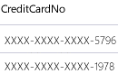
Dynamic Data Masking
Table.CreditCardNo
4465-6571-7868-5796
4468-7746-3848-1978
4484-5434-6858-6550
Masks data to prevent non-privileged users from seeing sensitive data
Administrators specify how much data to reveal
Applied when query results are returned: no data changes
Multiple masking functions are available for different sensitive data categories
Real-time data masking
Notes:
Dynamic data masking limits sensitive data exposure by masking it to non-privileged users. It helps prevent unauthorized viewing of sensitive data by enabling administrators to specify how much sensitive data to reveal. With dynamic data masking, the data in the warehouse isn’t changed. Data stays the same in the warehouse but the data is masked when it’s returned to users who query a table. There are 5 masking functions available for various categories of sensitive data.

Slide 75
Masking Rules
Masking Type | Description | Use Case | Limitations | Masking Rule
Default | Full mask according to the data types of the designated fields. | Useful when you want to completely hide actual data. | Completely masks the data. No information is visible. | Default()
Email | Exposes first letter of an email address and the constant suffix “.com” | Useful when you want to show the data field contains an email without revealing the actual email. | Only applicable to email fields | Email()
Custom text | Exposes the first and last ‘n’ characters and adds a custom padding string in the middle. | Useful when you want to partially hide the actual data. | Not suitable for numeric, date, and time data types. | Partial(prefix_padding,padding_string, suffix_padding)
Random | Replaces any numeric or binary value with a random number within a specified range. | Useful when you want to hide the actual numeric or binary data. | Only applicable to numeric and binary data types. | Random(low, high)
Notes:
The chart on this slide summarizes the five types of masks available in Fabric Warehouse. Dynamic data masking, which is set up at the column level, offers a number of masking options including full masking with the ‘default’ mask and partial masking capabilities with the ‘email’ and ‘custom text’ masks, along with a random masking function designed for numeric data.
<Review the descriptions and use cases above>
In the partial() function, the prefix_padding and suffix_padding specify the number of characters to expose at the beginning and end of the string, and the padding_string parameter specifies the string to use for masking the remaining characters.
In the random() function, the low and high parameters specify the range of random numbers to generate.

Slide 76
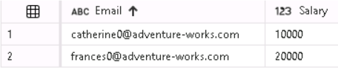
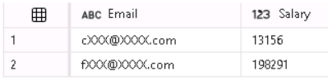
How to configure Dynamic Data Masking
CREATE or ALTER TABLE with ADD MASK
GRANT UNMASK to privileged users
Non-privileged users see masked data
Privileged and administrative users or roles see unmasked data
SELECT Email, Salary
FROM Employee
Add masks using T-SQL
kim2@adventure-works.com login sees:
ALTER TABLE Employee ALTER COLUMN Email
ADD MASKED WITH (FUNCTION = 'email()')
ALTER TABLE Employee ALTER COLUMN Salary
ADD MASKED WITH (FUNCTION = 'random(1,200000)’)
GRANT UNMASK ON Employee
TO [kim2@adventure-works.com]
Other logins see:
Notes:
<This slide is animated. Notes include where to <click> to advance the animation>
Let’s review the steps for making Dynamic Data Masking work.
Configure a column in a table for one of the 4 types of data masks with the CREATE TABLE or ALTER TABLE statements
Define a list of users that have access to the data and grant them UNMASK permissions on the table
When those users query the data, they can see the data in the format specified in the column definition
Administrative users or roles can view data unmasked
<click>
At the bottom left of the slide, there are some T-SQL examples of the syntax for altering a column in a table and adding a mask. Let’s review those. There’s an email mask applied to the email column and a random mask applied to the salary column. The user kim2@adventure-works.com is granted the UNMASK permission on the table and will be able to see the data unmasked. All other non-administrative users will see data in the email and employee columns masked.
<click>
On the bottom right is the output of different users querying the email and salary columns in the employee table. Kim2 sees the data unmasked, as shown in the top image. Other logins see the data masked, as shown in the bottom image.

Slide 77
Row-level security
Allows you to control which users can access specific rows of data
Data access is restricted based on user identity
Rows are not returned to users restricted from seeing them
Doesn’t change data in the warehouse
Example use case: salespeople should only see their orders, not orders for all salespeople
Salesperson 1
Salesperson 2
Salesperson 3
Fabric Warehouse
Notes:
Next let’s discuss Row-Level Security.
RLS is a feature that allows you to control which users can access specific rows of data. The access restriction is based on the identity of the user executing a query and if a user isn’t permitted to see the rows, they are silently filtered out of query results when the restricted user issues a query. There’s no change to data in the warehouse.
So when would RLS need to be implemented?
An example use case would be ensuring that workers can access only those data rows that are pertinent to their department, or customer’s can only see data relevant to their company or a salesperson can only see orders they placed.

Slide 78
How to implement row-level security
Determine roles and criteria for data access
Create Predicate Function
Determines criteria for user row access
Contains security logic and security predicate
Create Security Policy
Invokes the Predicate Function
Binds the Predicate Function to a table
Notes:
<This slide is animated. Notes include where to <click> to advance the animation>
We saw on the last slide that RLS enables you to implement restrictions on table row access. For example, you can ensure that users can access only those table rows that are pertinent to their department, or you can restrict a customer’s data access to only the data relevant to his or her orders.
Rows are filtered based on the execution context of the user issuing a query. RLS works by associating a function, which has a security predicate, with a table. The function is defined to return true or false based on certain conditions and it is associated with a table using a security policy.
<click>
To implement RLS, three steps must be followed:
1. First determine the roles and criteria for accessing data.
<click>
2. Then create a predicate function to determine the criteria for enabling row access.
<click>
3. Finally, create a security policy. The security policy binds the function to a table and it calls the predicate function when a query is run on a table. It filters rows that are returned based on the criteria in the function

Slide 79
Row-level security example
Scenario: Sales reps can only see rows associated with their orders in a Sales table. They cannot see rows placed by other sales reps.
Function
Evaluates who is querying the table. Return 1 (true) when a value in the SalesRep column in a row is the same as the user executing a query.
CREATE FUNCTION rls.fn_securitypredicate(@SalesRep AS VARCHAR(60))
RETURNS TABLE
WITH SCHEMABINDING
AS
RETURN SELECT 1 AS fn_securitypredicate_result
WHERE @SalesRep = USER_NAME();
Security Policy
Associates the function with the Sales table and invokes the function when the Sales table is queried. Silently filters rows available to read operations (SELECT, UPDATE, and DELETE).
CREATE SECURITY POLICY SalesFilter
ADD FILTER PREDICATE rls.fn_securitypredicate(SalesRep)
ON dbo.Sales
WITH (STATE = ON);
Notes:
<This slide is animated. Notes include where to <click> to advance the animation>
The T-SQL code on this slide shows an example of how row-level security is implemented.
<click>
Let’s review the scenario for this example:
Assume there’s a Sales table that contains sales rep names and the orders they have placed. When a sales rep queries the table to see their orders, they should only see rows associated with the orders they placed, not the orders place by other sales reps.
To enforce this scenario, row level security is needed. A function and a security policy need to be created. The function identifies who is executing a query. The security policy binds the function to the Sales table and invokes the function to filter rows returned from queries on the Sales table. If the user executing a query is the same value as the SalesRep in a row that’s being evaluated for filtering, that row is returned. If the user executing a query is not the same as value in the SalesRep column in a row, that row is not returned.
<click>
Function
First let’s review how to create the function. A function is needed to evaluate who is querying the table. The function has what’s called a security predicate. A predicate evaluates to true (1) or false (0). The security predicate in this example returns 1 (true) when a row in the SalesRep column is the same as the user executing the query.
This function is called by the security policy. If the SalesRep (@SalesRep) name passed to this function as a parameter is the same user as the user executing the query (USER_NAME), return 1 (true).
<click>
Security Policy
Next let’s review how to create the security policy. The purpose of the security policy is to invoke and enforce the function each time a query is run on the Sales table. The security policy has a filter predicate that silently filters the rows available to read operations (SELECT, UPDATE, and DELETE).

Slide 80
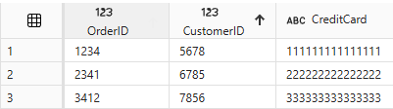
Column-level security
Restricts column access in a table
Implemented using GRANT SELECT and DENY SELECT permissions
Example
Allow [mary@contoso.com] to see all columns in an Orders table except the CreditCard column
GRANT SELECT ON Orders TO [mary@contoso.com];
DENY SELECT ON Orders (CreditCard) TO [mary@contoso.com];
SELECT * FROM Orders;
mary@contoso.com sees:
Error: The SELECT permission was denied on the column 'CreditCard' of the object ‘Orders', database 'Sales', schema 'dbo'
Non-restricted users see:
Notes:
<This slide is animated. Notes include where to <click> to advance the animation>
Column-level security lets you to designate which users can access specific columns in a table. It's implemented by issuing a GRANT or DENY statement on a table specifying a list of columns and the user or role that can or cannot read them. To make user management easier, assign permissions to roles instead of individual users.
How does it work?
When a user has been granted read access to table without column-level security applied, and they run a SELECT * query, all of the columns for each row of data are returned. But if column level security has been applied to a column in a table for a particular user or role, when the restricted user runs a SELECT * on the table, they will get a ‘permission denied’ error. They can however successfully run a SELECT on the columns they have access to.
<click>
Let’s look at an example.
Consider a scenario where we have an orders table that has a credit card column. Let’s assume we want to restrict mary@contoso.com’s access to the credit card column. The first thing to do is grant mary@contonso.com the ability to read data in the table using the statement ‘GRANT SELECT on Orders to mary@contoso.com’. If we had only issued this SELECT statement, Mary could read all data in the table. To restrict Mary’s access to the creditcard column, we need to issue the statement ‘DENY SELECT ON Orders (CreditCard)’ to mary@contoso.com.
<click>
Now that Mary’s access to the CreditCard column in the orders table has been restricted, when Mary queries the Orders table, with SELECT * or a query that includes the CreditCard number, she will get an error: ‘The SELECT permission was denied on the column 'CreditCard' of the object ‘Orders', database 'Sales', schema 'dbo’.
Users whose column-level access has not been restricted will be able to see the data in all columns in each row when they run a SELECT *.

Slide 81
Granular permissions using T-SQL
Fine-grained access control on warehouse securables
Tables, views, procedures
Uses SQL data control language commands
GRANT, DENY, REVOKE
Use when Fabric workspace roles and item permissions aren’t specific enough
DENY SELECT on dbo.Parts to [RoleName];
GRANT EXECUTE on dbo.sp_UpdateParts to [RoleName];
Notes:
Fabric controls data access using workspaces. Within a workspace Fabric has items. Items refer to apps, lakehouses, warehouses, reports and other things. We can assign permissions at the workspace and at the item level. The item permissions and workspace roles we can assign come with default permissions, but sometimes those permissions are not granular enough. They might allow more access than we want a user to have. That’s when we use T-SQL granular permissions to refine T-SQL permissions to the level required..
We use standard T-SQL constructs when we need to assign more granular permissions than what we get with the workspace roles or item permissions.
For Fabric Warehouse, object-level security can be managed using the GRANT, REVOKE, and DENY T-SQL syntax and users can be assigned to custom and built-in database roles.
If you're familiar with relational databases and enterprise warehouses, you know that there are four fundamental permissions governing Data Manipulation Language (DML) operations. These permissions are SELECT, INSERT, UPDATE, and DELETE, and are universally applicable across all database platforms.
All of these permissions can be granted, revoked or denied on tables and views. If a permission is granted using the GRANT statement, then the permission is given to the user or role referenced in the GRANT statement. Users can also be denied permissions using the DENY command. If a user is granted a permission and denied the same permission, the DENY will always supersede the grant, and the user will be denied access to the specific object.
See: Permission model - Microsoft Fabric | Microsoft Learn

Slide 82
Exercise
Secure a warehouse in Microsoft Fabric
30 minutes
Notes:
https://aka.ms/mslearn-secure-fabric-warehouse
The estimated time to complete this exercise is 30 minutes.

Slide 83
Knowledge check
1
What is the primary advantage of Dynamic Data Masking (DDM)?
It limits data exposure by obscuring sensitive information in real time.
It changes the actual data in the database
It requires complex coding to implement.
2
What is the purpose of a security predicate function in Row-Level Security (RLS)?
It determine whether a row is accessible to a user based on certain criteria.
It enables type conversions in predicate functions.
It allows users to run ad hoc queries
3
What happens when a user is granted a permission then denied the same permission in a warehouse?
The GRANT statement supersedes the DENY, and the user will have access to the specific object.
The DENY always supersedes the GRANT, and the user is denied access to the specific object.
The user has both permissions, and it causes a conflict.
Notes:
Allow students a few minutes to think about the questions, and then use the animated slide to reveal the correct answers.

Slide 84
Recap
In this section, we covered:
Dynamic Data Masking (DDM)
Row-Level Security (RLS)
Column-level security (CLS)
Granular SQL permissions

Slide 85
Further Reading
Secure a Microsoft Fabric data warehouse
https://aka.ms/fabric-securedw
Notes:
Encourage students to review the online material on Microsoft Learn on which this presentation is based.

